Slide 1
REACHES meeting - Vivaldi antenna design
Nicolas Fagnoni – 22/05/2019
nf323@mrao.cam.ac.uk – University of Cambridge – Astrophysics Group

Slide 2
Summary
Fat Vivaldi antenna
Dual ridge horn antenna
Feeding

Slide 3
Fat Vivaldi antenna

Slide 4


Fat Vivaldi

Slide 5
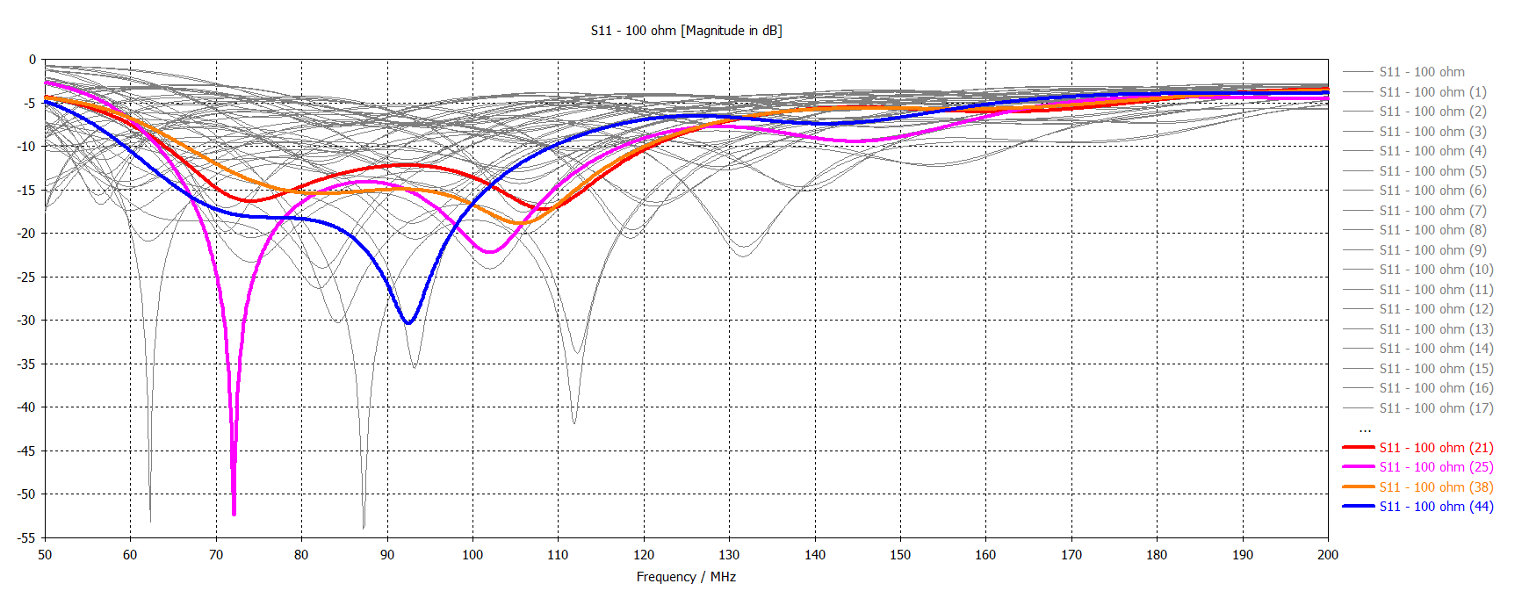
Fat Vivaldi

Slide 6
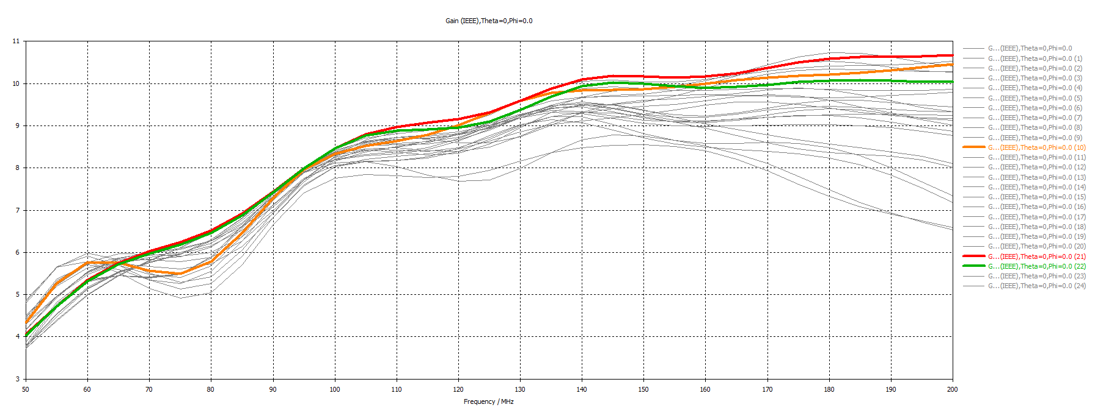
Fat Vivaldi

Slide 7
Dual ridge horn antenna

Slide 8
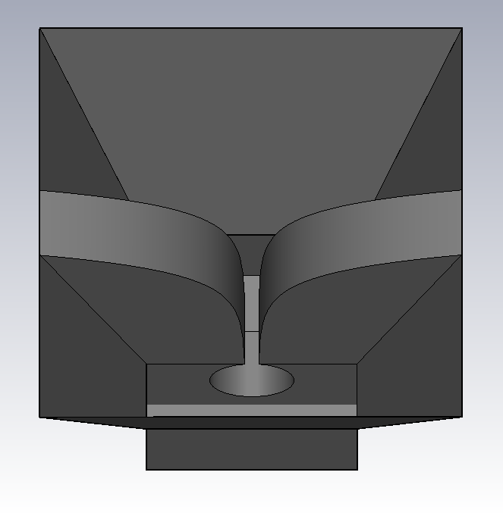
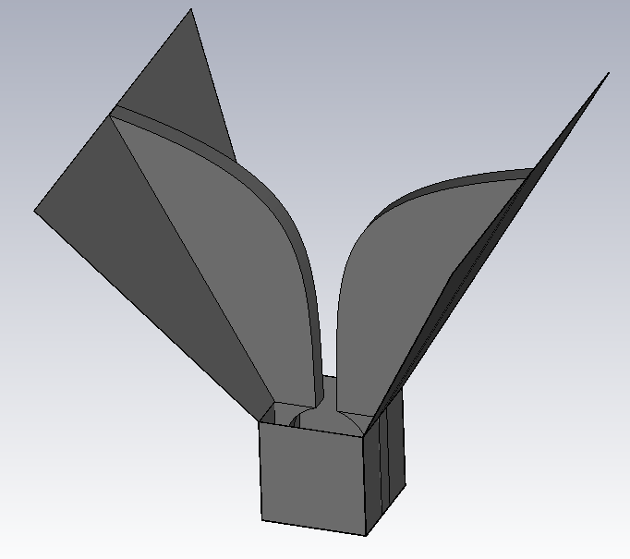
Models and parametrisation
Fully parametrised model
Aperture width
Aperture rate
Height
Dimensions of the rectangular horn
Dimensions of the base
Radius of the stub
Width of the blades
Thickness of the metal
Horn half or fully closed

Slide 9
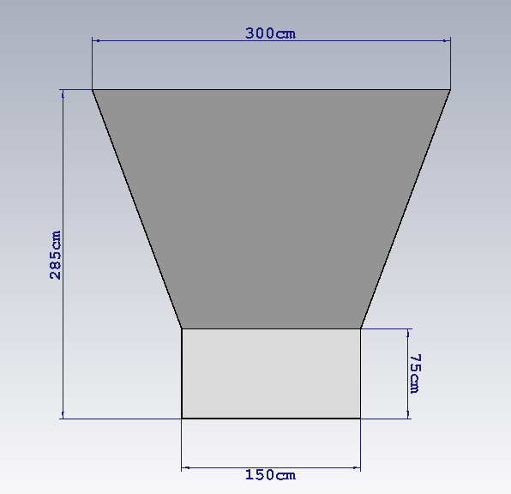
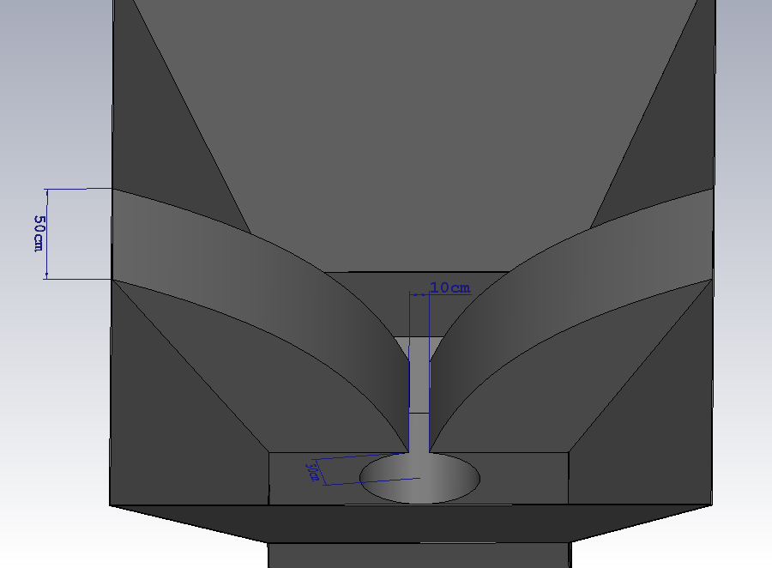
Model

Slide 10
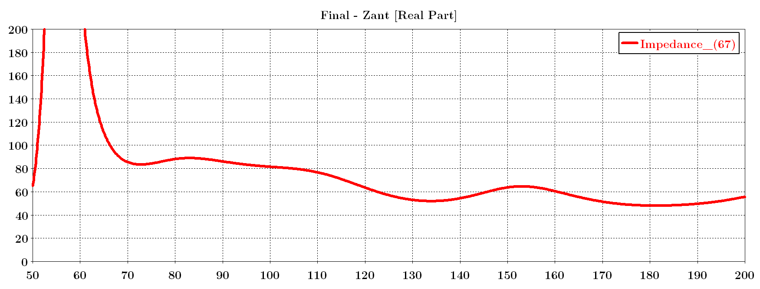
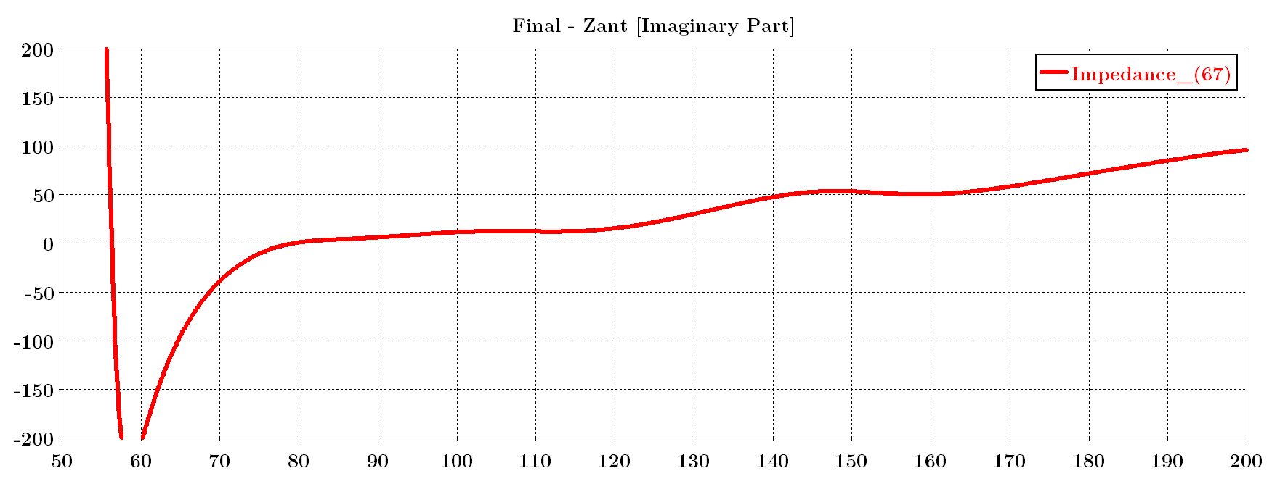
Antenna impedance

Slide 11
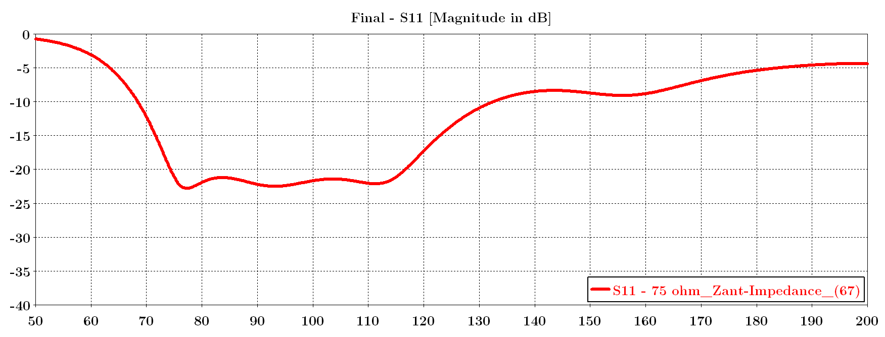
S11 – with respect to 75 ohm

Slide 12
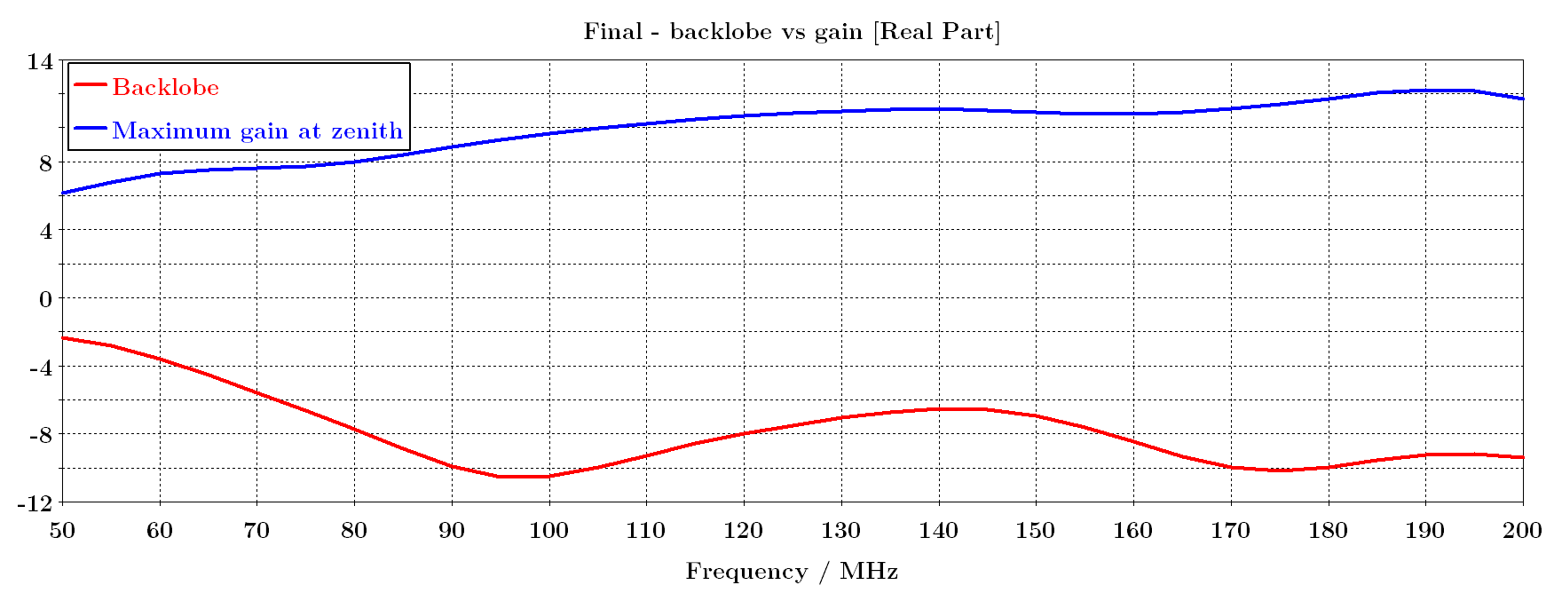
Gain and backlobe

Slide 13
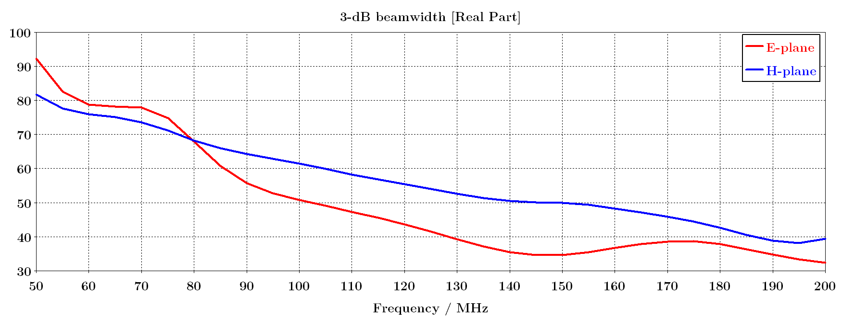
Beamwidth

Slide 14
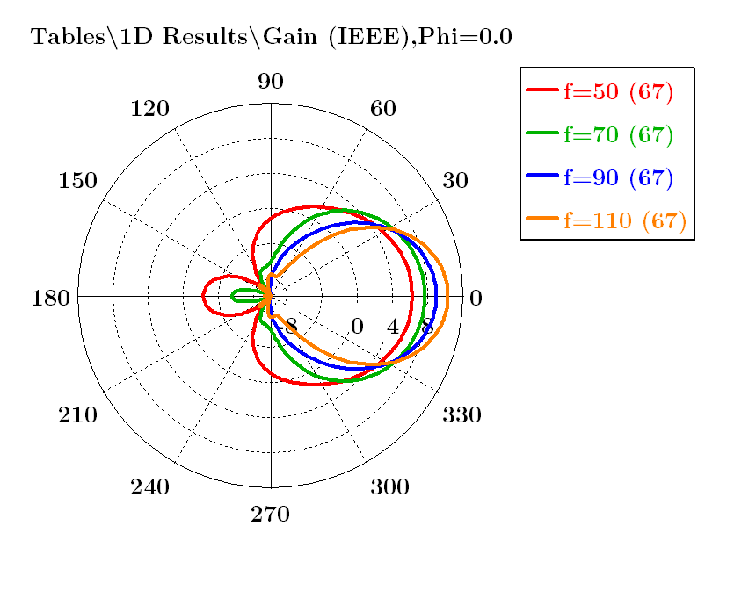
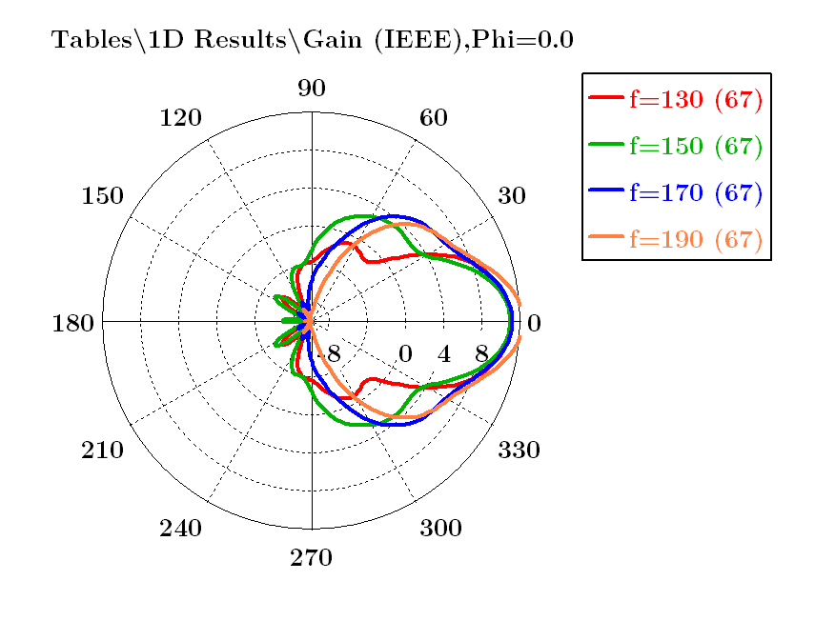
Beam – E-plane – dB scale (-10 dB – 12 dB)

Slide 15
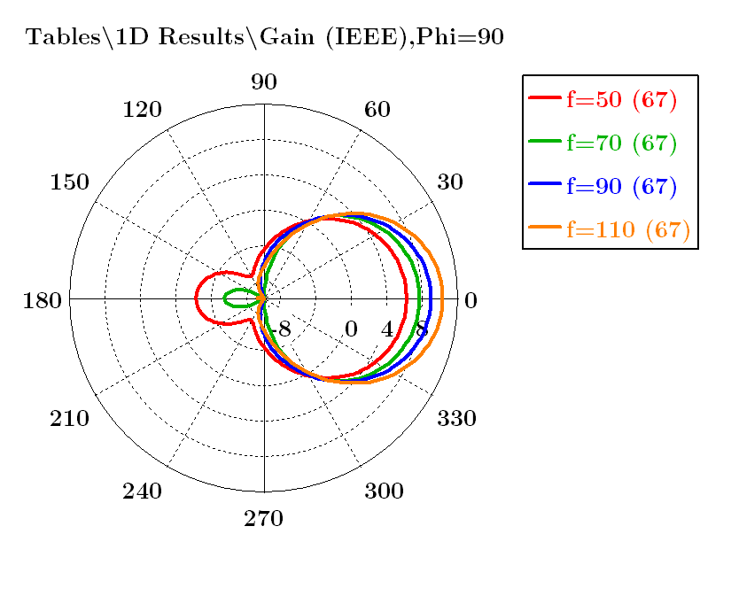

Beam – E-plane – dB scale (-10 dB – 12 dB)

Slide 16
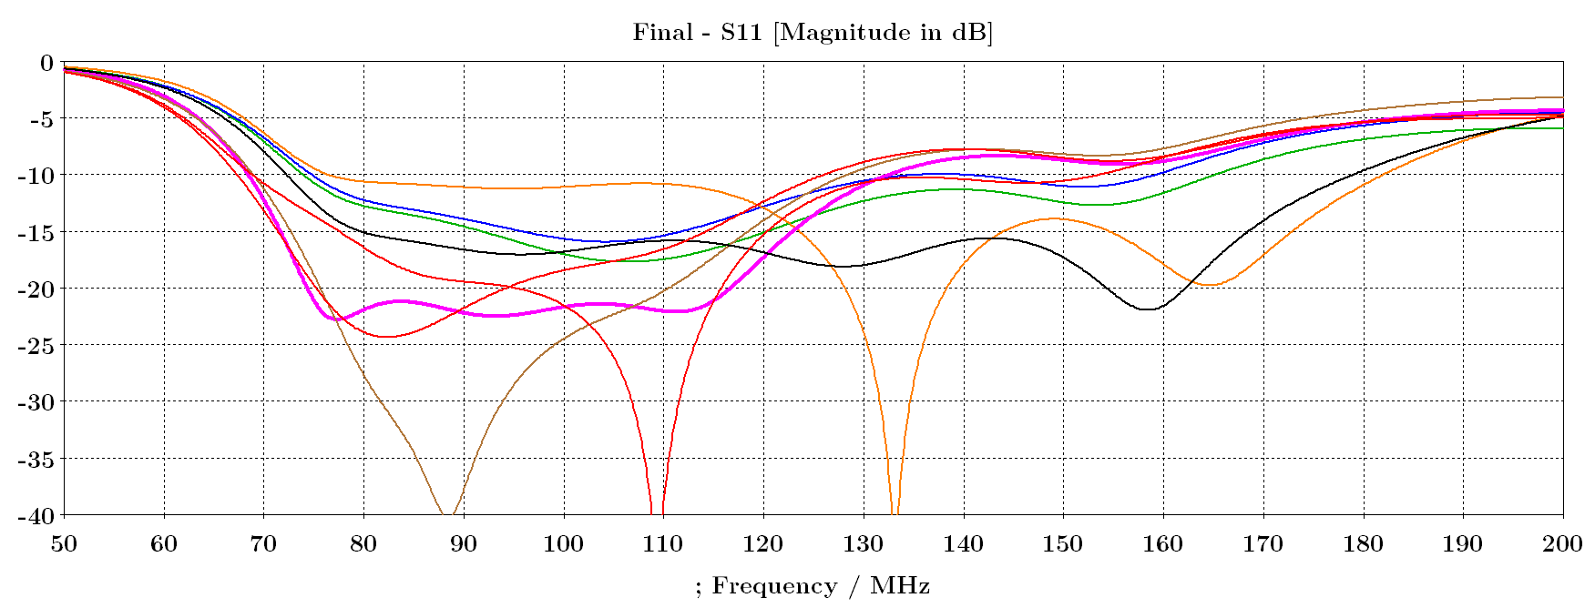
Other solutions

Slide 17
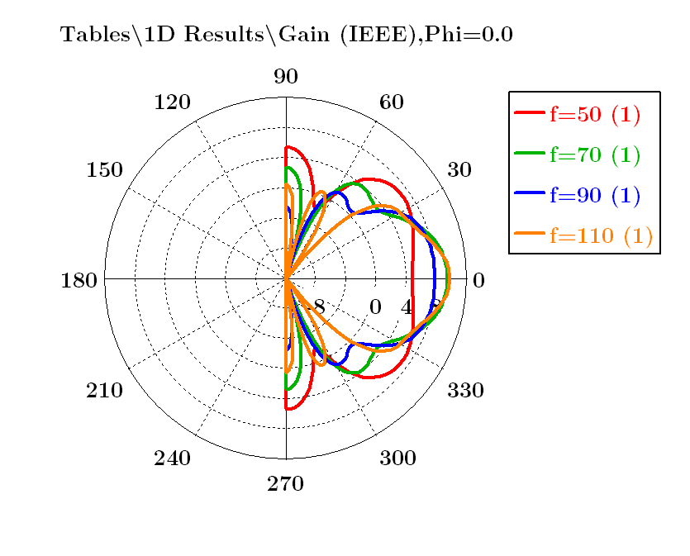
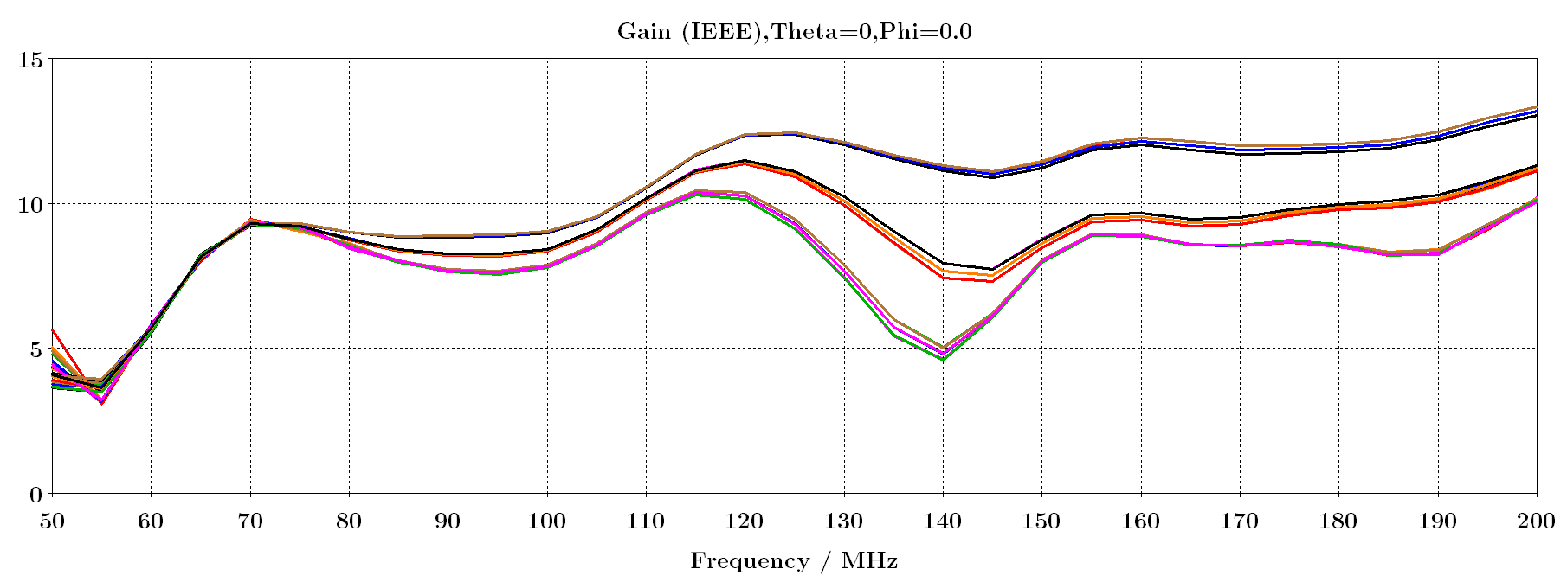
With a groundplane

Slide 18
Feeding

Slide 19
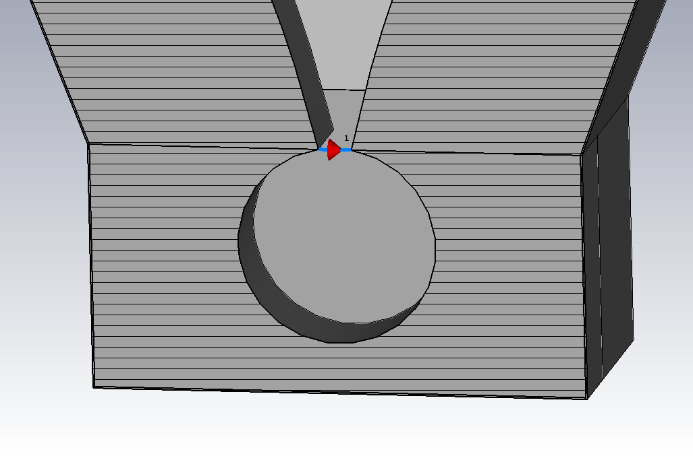
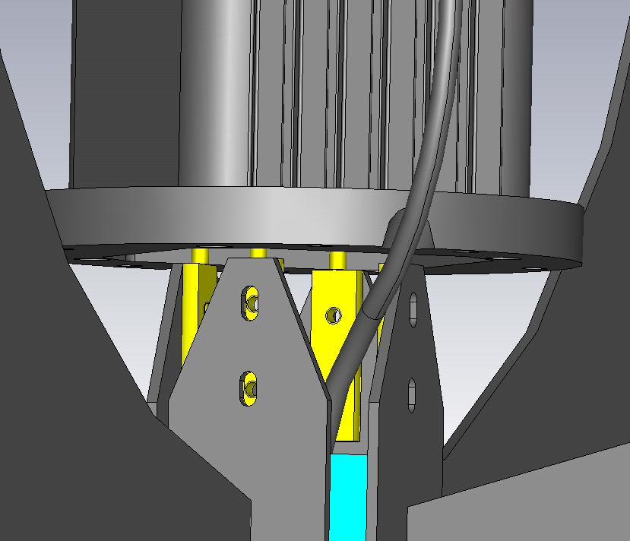
Feeding
Feeding from the BACK or SIDE of the stub
Balanced feeding
Pins or coax cable

